Slide 1
Google Trends as a Sentiment Indicator in Algorithmic Trading
Group D
Guy Glatt, Hillel Charbit, Tom Geva

Slide 2
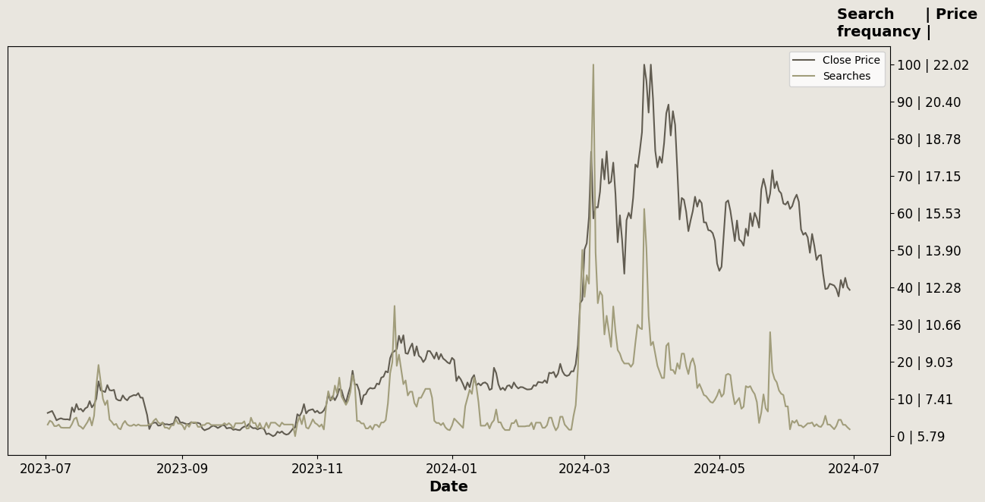
Main IDEA
Google Searches & Stock Price Relationship

Slide 3
tools
Google Trends
Glimpse
Python APIs – Pytrends, Binance

Slide 4
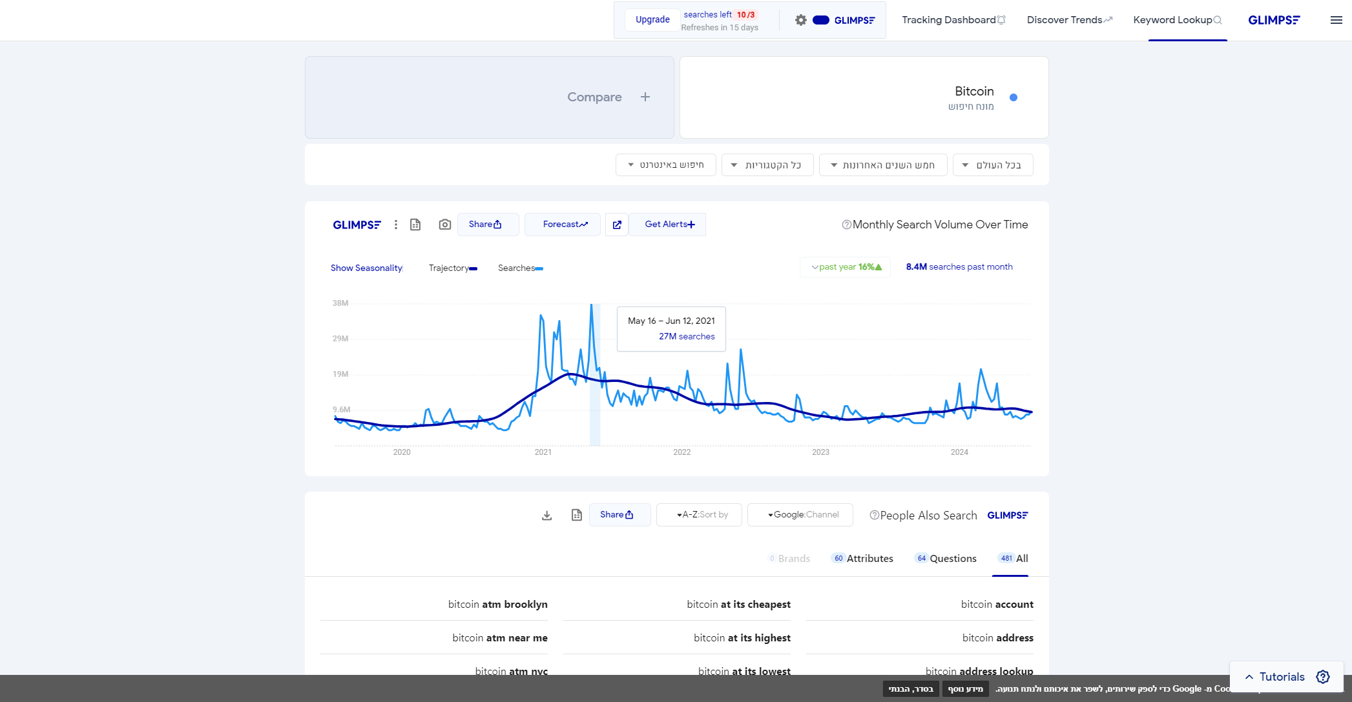
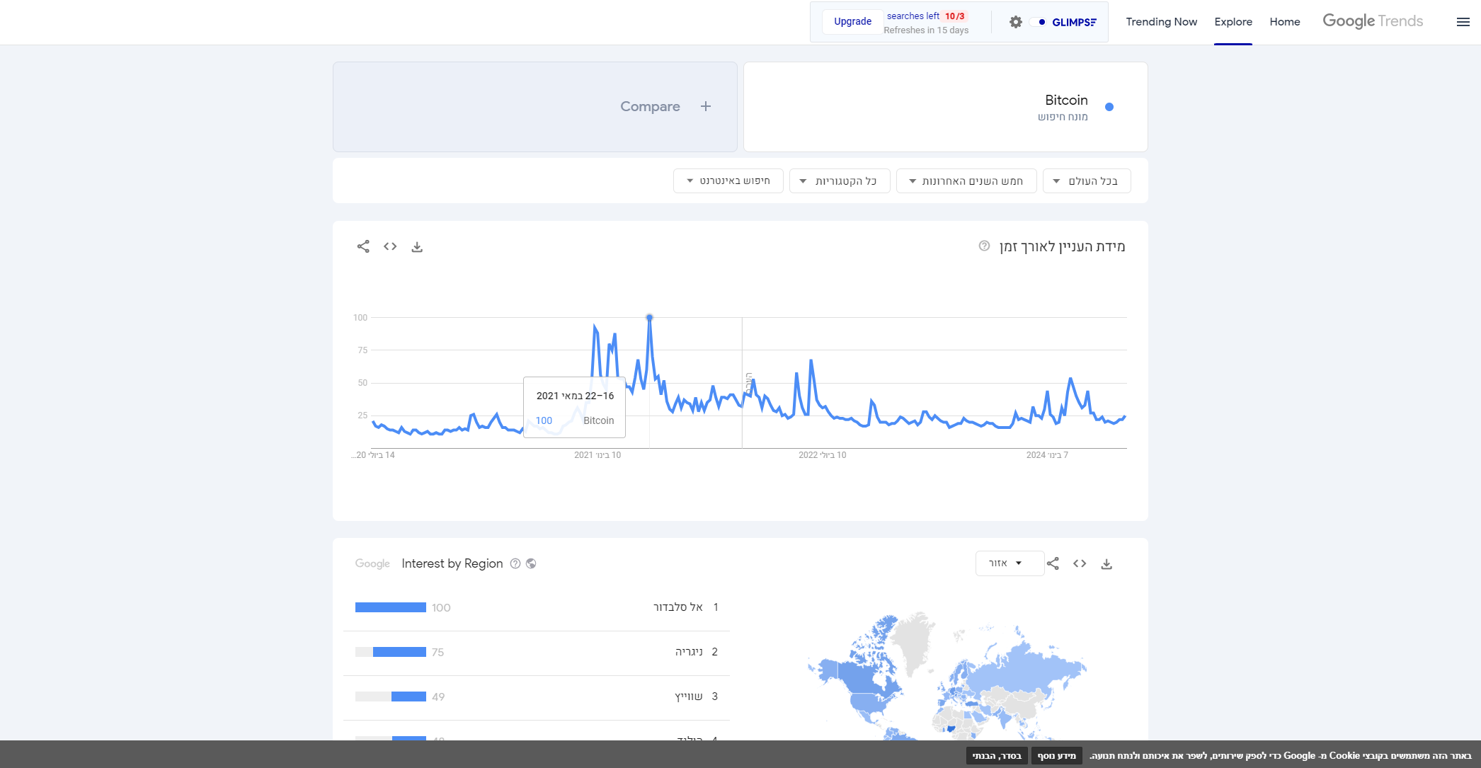

Slide 5
General plan
Simple idea, Complex Execution
Comparison with Buy & Hold

Slide 6
Data normalization
Using Glimpse for Approximation
Data Cleaning & Normalization

Slide 7
Strategy & backtesting
Filtering Coins
Signal Calculation
Notes:
שימוש ב:
Bollinger Band: אינדיקטור וולטיליות מבוסס על ממוצע נע המיושם על הטרנד
RSI: אינדיקטור לקנייה/מכירה מבוסס על חדות השינוי במחיר
Stop loss.

Slide 8
Results
Performance Metrics & Comparison
 | Our Strategy |  | Buy & Hold Strategy
 | Train | Test | Train | Test
Annual Return
Sharpe
Max Drawdown
Calmar Ratio
 | Our Strategy |  | Buy & Hold Strategy
 | Train | Test | Train | Test
Annual Return | 150.94% | 175.83% | 134.38% | 162.65%
Sharpe | 1.51 | 1.76 | 1.34 | 1.63
Max Drawdown | 86.06% | 75.72% | 89.29% | 35.66%
Calmar Ratio | 1.75 | 2.32 | 1.50 | 4.56

Slide 9
Possible strategy improvements
Good strategy to support decision making
Implement the data scraper to improve accuracy & reaction time
Minimize time window
Implement machine learning based models instead of a simple grid search

Slide 10
Any question?

